Slide 1
AUTOMATION IN MANUFACTURING (MEC-401A)
B.Tech. 7th Semester
Unit-1
Dr. Mukesh Kumar
Assistant Professor (Guest Faculty)
Mechanical Engineering Department

Slide 2
AUTOMATION
Defination: Automation can be defined as a technology concerned with the application of electronic, mechanical and computer- based systems to operate and control the production.

Slide 3
Automation
“To perform a task ,without human intervention to improve the productivity and quality”.
CNC Machines, Automated guided vehicles, robots etc……

Slide 4
Reasons for automation
To reduce labor cost.
To mitigate the effects of labor shortages.
To reduce or eliminate routine manual and clerical tasks.
To improve worker safety.
To improve product quality
To reduce manufacturing lead time.
To accomplish processes that cannot be done manually.
To Increase labor productivity.

Slide 5
Production Systems
- That are used to manufacture products and the parts assembled into those products.
- Production system is the collection of people equipment and procedures organized to accomplish the manufacturing process of a company.

Slide 6
Production systems can be divided in two categories:
Manufacturing support systems
Facilities : Factory Equipment

Slide 7
Facilities
The facilities of the production consist of the factory, the equipment in the factory and the way the equipment is organized.

Slide 8
Production System

Slide 9
Automation in production system

Slide 10
Manual labor in production system
Is there a place for manual labor in the modern production system? The answer is yes. Even in a highly automated production system, humans are still a necessary component of the manufacturing enterprise. The discussion of the labor issue is separated into two parts,
corresponding to the previous distinction between facilities and manufacturing support: (1) manual labor in factory operations and (2) labor in manufacturing support systems.

Slide 11
Automation Principles and Strategies
Automation is not always the right answer for a given production situation. A certain caution and respect must be observed in applying automation technologies.
Three approaches for dealing with automation projects
1. USA Principle
2. Ten Strategies for Automation and Production Systems
3. Automation Migration Strategy

Slide 12
USA Principle
Understand the existing process
Simplify the process
Automate the process
USA approach is applicable to nearly any automation project

Slide 13
Understand the existing process
The first step in the USA approach is to comprehend the current process in all of its details.
What are the inputs? What are the outputs ?
What exactly happens to the work unit between input and output?
What is the function of process?
How does it add value to the product?
What are the upstream and downstream operations in the product sequence, and can they be combined with the process under consideration?.

Slide 14
Simplify the process
Once the existing process is understood, then the search can began for ways to simplify. This often involves a checklist of questions about the existing process.
Unnecessary steps can be eliminated without detracting from the function.

Slide 15
Automate the process
Once the process has been reduced to its simplest form then automation considered. The possible form of automation include those listed in the ten strategies.

Slide 16
Ten Strategies for Automation and Production Systems
Automation seems a feasible solution to improving productivity, quality, or other measure of performance then the following ten strategies for these improvements discussed.
Specialization of operations: The first strategy involves the use of special-purpose equipment designed to perform one operation with the greatest possible efficiency. This is analogous to the concept of labor specialization. Which is employed to improve labor productivity.
Combined operations: Production occurs as a sequence of operations. Complex parts may require dozens, or even hundreds, of processing steps. The strategy of combined operations involves reducing the number of distinct production machines or work stations.

Slide 17
3. Simultaneous operations: A logical extension of the combined operations strategy is to simultaneously perform the operations that are combined at one work-stations. In effect two or more processing (assembly) operations are being performed simultaneously on the same work part. 4. Integration of operations: Another strategy is to link several work stations together into a single mechanism, using automated work handling devices to transfer parts between stations. 5. Increased flexibility: This strategy attempts to achieve maximum utilization of equipment for job shop and medium value situations by using the same equipment for a variety of parts. 6. Improved material handling and storage: A great opportunity for reducing non-productive storage systems. time exists in the use of automated material handling and

Slide 18
7. On-line inspection: Inspection for quality of work is traditionally performed after the process is completed. This means that any poor-quality product has already been produced by the time it is inspected. 8. Process control and optimization: Manual control to automated control by optimization we can give the best parameters. Then the individual process can be reduced. 9. Plant operation control: Those which are not related fabrication process, each division specify automate. Business functions, product design. 10. Computer- integrated manufacturing: Input from market delivery to the final customer every operation is integrated to the computer. Business functions, product design etc…..

Slide 19
Manufacturing and Product
Manufacturing can be defined as the application of physical and/or chemical processes to alter the geometry, properties, and/or appearance of a given starting material to make parts or products. Manufacturing also includes the joining of multiple parts to make assembled products.

Slide 20
Alternative definitions of manufacturing: (a) as a technological process and (b) as an economic process.

Slide 21
Manufacturing operations
For converting raw material to finished product
There are four activities.
1. Processing and assembly operation
2. Material handling
3.Inspection and testing
4.Coordination and control

Slide 22
Manufacturing operations /Classification of manufacturing process

Slide 23
Product Facilities
A manufacturing company attempts to organize its facilities in the most efficient way to serve the particular mission of each plant.
The quantity of parts and/or products made by a factory has a very significant influence on its facilities and the way manufacturing is organized. Production quantity refers to the number of units of a given part or product produced annually by the plant.
It has three types
1. Low production: Quantities in the range of 1 to 100 units
2. Medium production: Quantities in the range of 100 to 10,000 units
3. High production: Production quantities are 10,000 to millions of units.

Slide 24
Product/ Production relationship

Slide 25
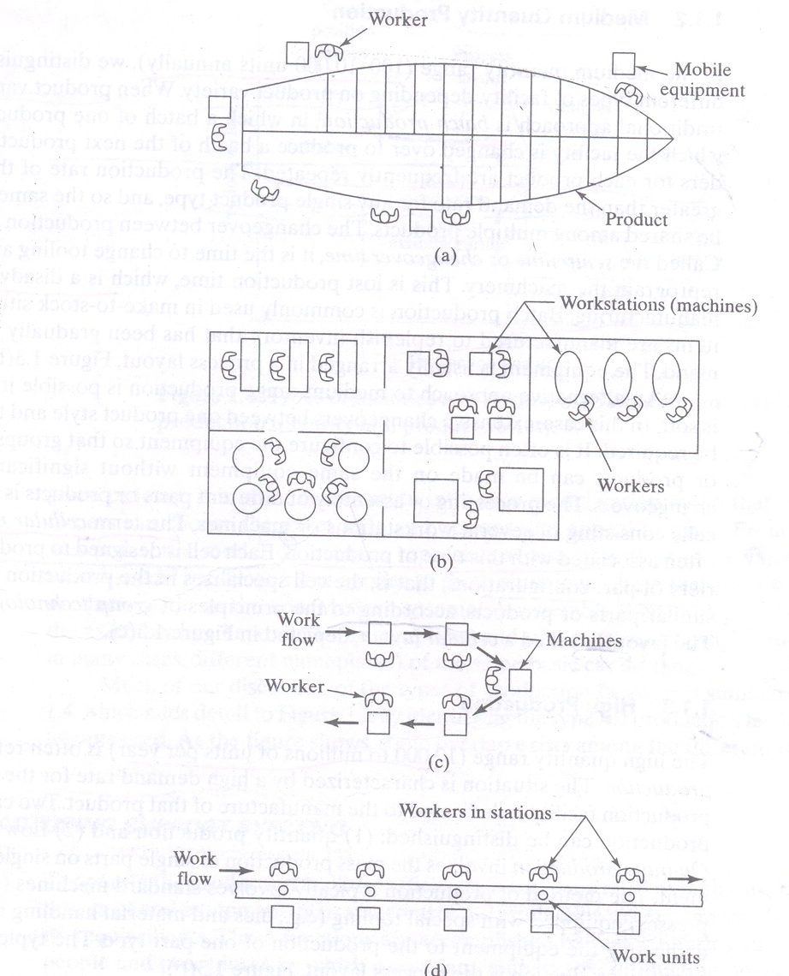
Fixed-position layout
Process layout
Cellular layout
Product layout
Various types of plant layout

Slide 26
Fixed-position layout : Workers and processing equipment are brought to the product, rather than moving the product to the equipment .This type of layout referred to as fixed-position layout. Process layout: The individual parts that comprise these large products are often made in factories that have a process layout.

Slide 27
Cellular layout: The term cellular manufacturing often associated with this type of production. Each cell is designed to produce a limited variety of part configurations. That is the cell specializes in the production of a given set of similar parts or products according to the principles of group technology.
Product layout: The collection of stations is designed specifically for the product to maximize efficiency.

Slide 28
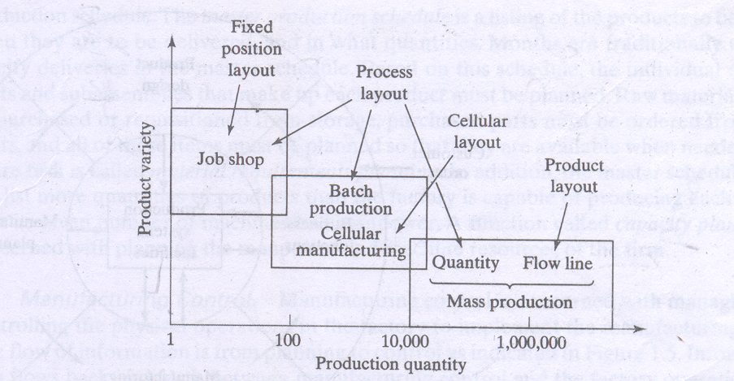
Types of facilities and layouts used for different levels of production quantity and product variety

Slide 29
Basic elements of an automation system
An automated system consists of three basic elements: (1) power to accomplish the process and operate the system.
(2) A program of instructions to direct the process.
(3) a control system to actuate the instructions.

Slide 30
Basic elements of an automation system

Slide 31
Advance Automation Function,
1.Saftey Monitoring.
2.Maintence and Repair Diagnostic.
3.Error Detection and Recovery.

Slide 32
Level of Automation

Slide 33
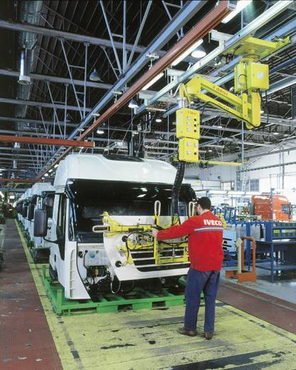
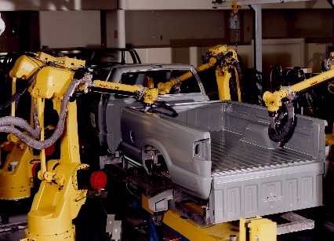
What is a Robot
The difference between a robot and a manipulator
Run by a computer or microprocessor not a human
Controlled by feedback devices
Mostly autonomous

Slide 34
What is a Robot ?
Random House Dictionary A machine that resembles a human being and does mechanical routine tasks on command.
Robotics Association of America An industrial robot is a re-programmable, multifunctional manipulator designed to move materials, parts, tools, or specialized devices through variable programmed motions for the performance of a variety of tasks.

Slide 35
What is a Robot ?
A manipulator (or an industrial robot) is composed of a series of links connected to each other via joints. Each joint usually has an actuator (a motor for eg.) connected to it.
These actuators are used to cause relative motion between successive links. One end of the manipulator is usually connected to a stable base and the other end is used to deploy a tool.

Slide 36
Classification of Robots
- JIRA (Japanese Industrial Robot Association)
Class1: Manual-Handling Device
Class2: Fixed Sequence Robot
Class3: Variable Sequence Robot
Class4: Playback Robot
Class5: Numerical Control Robot
Class6: Intelligent Robot

Slide 37
Classification of Robots
- RIA (Robotics Institute of America)
Variable Sequence Robot(Class3)
Playback Robot(Class4)
Numerical Control Robot(Class5)
Intelligent Robot(Class6)

Slide 38
What is Robotics
♦ History of Robotics
1922: Karel Čapek’s novel, Rossum’s Universal Robots, word “Robota” (worker)
1952: NC machine (MIT)
1955: Denavit-Hartenberg Homogeneous Transformation
1967: Mark II (Unimation Inc.)
1968: Shakey (SRI) - intelligent robot
1973: T3 (Cincinnati Milacron Inc.)
1978: PUMA (Unimation Inc.)
1983: Robotics Courses
21C: Walking Robots, Mobile Robots, Humanoid Robots

Slide 39
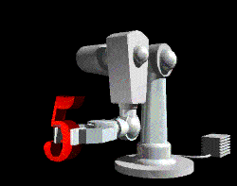
What are the parts of a robot?
Manipulator
Pedestal
Controller
End Effectors
Power Source

Slide 40
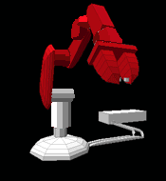
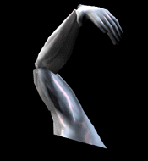
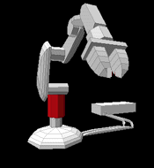
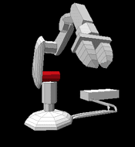
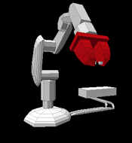
Manipulator
Base
Appendages
Shoulder
Arm
Grippers

Slide 41
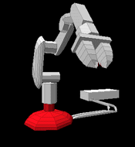
Pedestal
(Human waist)
Supports the manipulator.
Acts as a counterbalance.

Slide 42
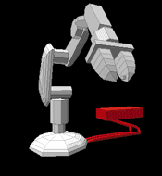
Controller
(The brain)
Issues instructions to the robot.
Controls peripheral devices.
Interfaces with robot.
Interfaces with humans.

Slide 43
End Effectors
(The hand)
Spray paint attachments
Welding attachments
Vacuum heads
Hands
Grippers

Slide 44
Controller
(The brain)
Issues instructions to the robot.
Controls peripheral devices.
Interfaces with robot.
Interfaces with humans.

Slide 45
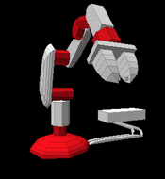
Power Source
(The food)
Electric
Pneumatic
Hydraulic

Slide 46
Robots degrees of freedom
Degrees of Freedom: Number of independent position variables which would has to be specified to locate all parts of a mechanism.
In most manipulators this is usually the number of joints.

